Slide 1
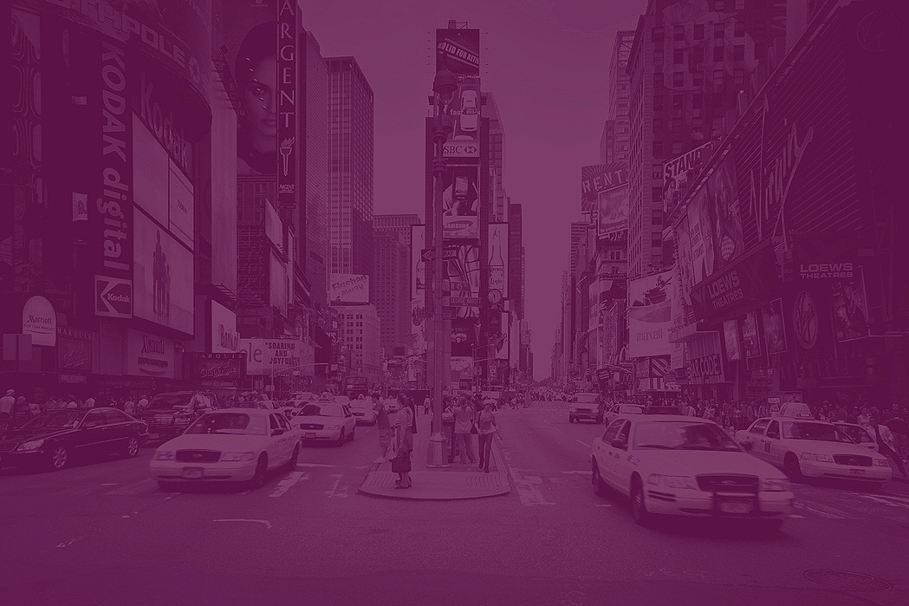
FDX Hackathon
NY - May 15, 2025
Team PayDX
Suman Devarasetti
Narasimha Murthy Kapa
Arvind Badri
Vidya Parameswaran
Mahesh Kotachery
Venkata Kanumuri

Slide 2
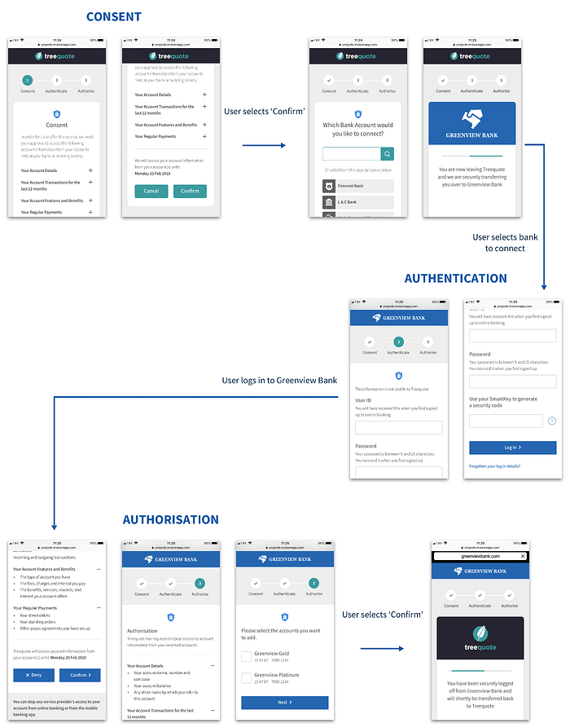
1. Problem Statement
Today’s financial data consent processes are static, confusing, and lack real-time personalization. Users often don’t understand what data they’re sharing, why it’s needed, or how to control it effectively.
Consumers: confusion, trust issues
Banks & FinTechs: low transparency, regulatory pressure, poor adoption
Open Banking promises consumer data control — but without intelligent consent management, it falls short of delivering real empowerment.

Slide 3
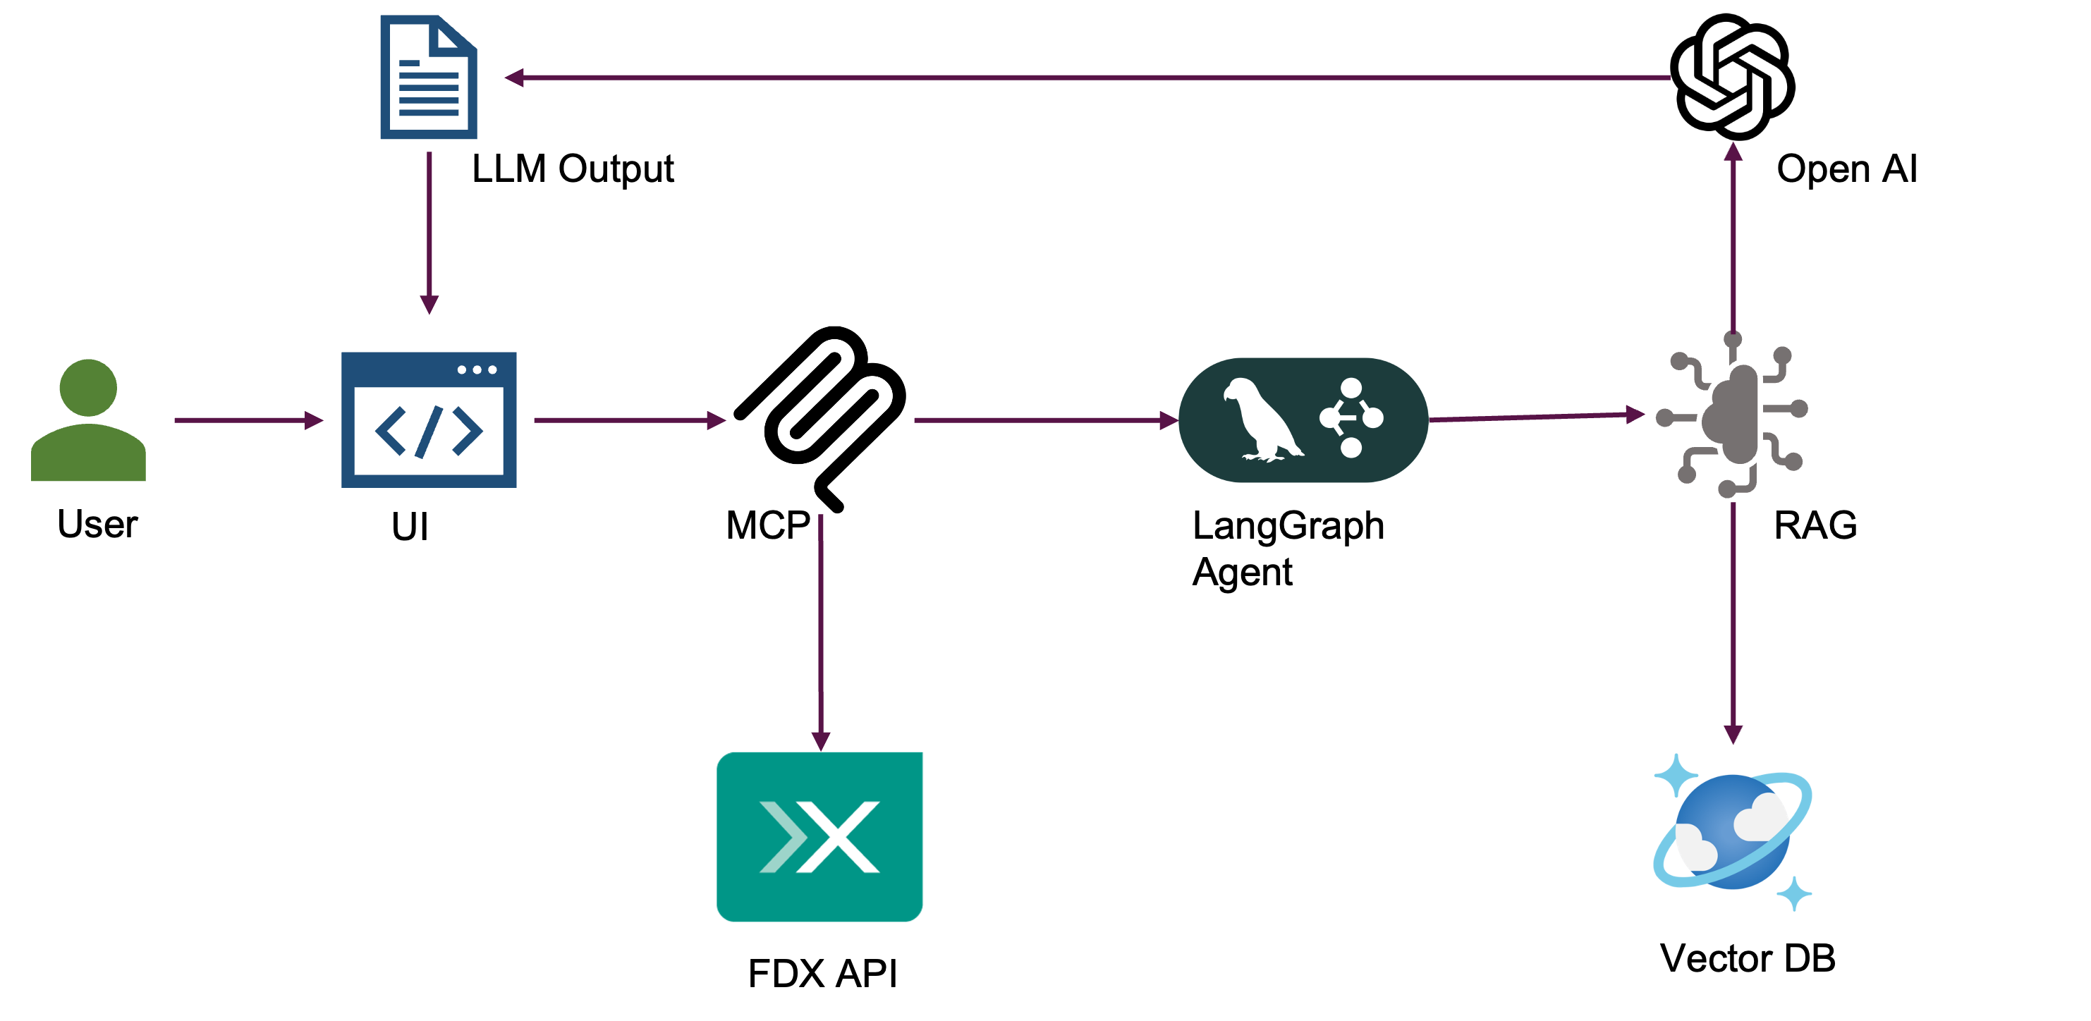
2a. Proposed Solution
Our Idea: Build an Smart Consent Manager using FDX APIs and AI agents. APIs don’t just serve data — they serve decisions.
How It Works:
Retrieve real-time consent data via FDX APIs
Augment context with RAG using Azure Cognitive Search
Reason with LangGraph agent orchestration
Summarize and explain consent clearly to users
Recommend actions and submit consent updates securely
Where FDX APIs Fit:
FDX Consent APIs: Fetch and update consent permissions
FDX Accounts APIs: Retrieve account details to personalize explanations
Innovation Highlight: First solution to integrate Agentic AI (LangGraph + MCP) with Open Finance — building APIs that think, reason, and act.

Slide 4
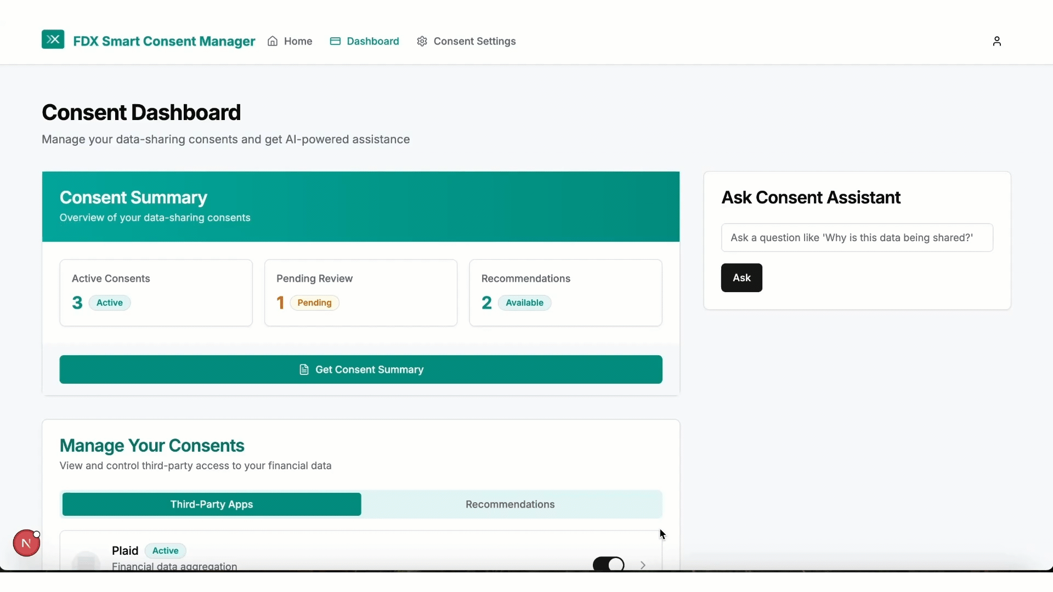
2b. FDX Smart Consent Manager Demo

Slide 5
3. Business Value
Who Benefits and How?
Consumers: clear control, trust, better understanding
Banks/Fintechs: faster consent onboarding, regulatory compliance, improved user retention
Expected Impact:
Boosted trust = increased user opt-in rates
Streamlined consent audits = compliance cost savings
Personalized experiences = new engagement revenue models
Market Type: B2B2C (Banks and Fintechs improving the consumer experience)

Slide 6
4. Competitive Advantage
What Makes PayDX Unique?
First to leverage Agentic AI and RAG in real-time consent management
Integrates FDX Open APIs + MCP-based AI agents seamlessly
Moves beyond dashboards to autonomous decision assistance
Existing Solutions: Static consent dashboards (banks/fintech apps). PayDX Difference: Dynamic, AI-powered, contextual consent guidance — personalized at runtime.
Early Validation:
Aligns with 2025 Open Finance regulatory trends (CFPB Data Rights Rule, DORA)
Built on emerging MCP standards (adopted by Anthropic, OpenAI frameworks)

Slide 7
5. FDX API Usage
APIs Utilized:
FDX Consent API: (Get, Update consent objects)
FDX Accounts API: (User account info for tailoring explanations)
Data Shared:
Consent scopes
Connected accounts
Authorized third-party apps

Slide 8
6. Feasibility
How Realistic?
FDX APIs and sandbox available
MCP Server (Spring Boot) + LangGraph client easily built
Azure OpenAI + Cognitive Search integration straightforward
Consent model aligns with U.S. regulatory frameworks (CFPB, Dodd-Frank 1033)
Path to Pilot:
Build minimal agent orchestrator MVP
Connect to live bank or sandbox APIs (FDX compliant)
User testing for consent journey UX

Slide 9
7. Who are we, Why our idea
Team PayDX:
Experts in Open Banking, Payments Modernization, API Architecture, and AI Engineering
Led by Suman Devarasetti, VP of Software Engineering, U.S. Bank — with deep industry experience modernizing banking APIs using AI-driven strategies
Why Pick Us?
We combine real-world Open Finance modernization expertise with emerging AI technologies.
We’re not just imagining future-ready consent — we’re building it today with Agentic APIs.

Slide 10
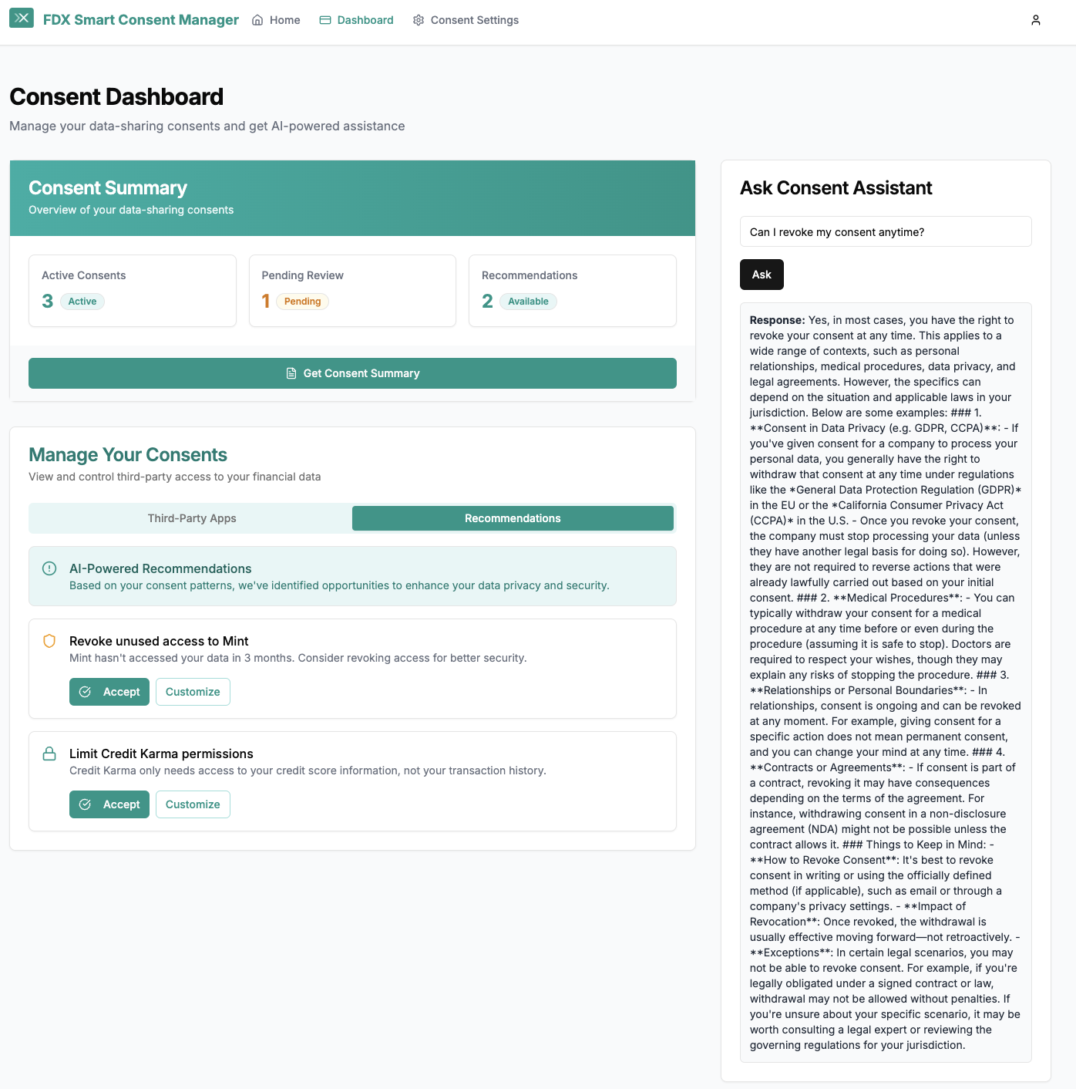
Appendix
Smart Consent Manager UI:

Slide 11
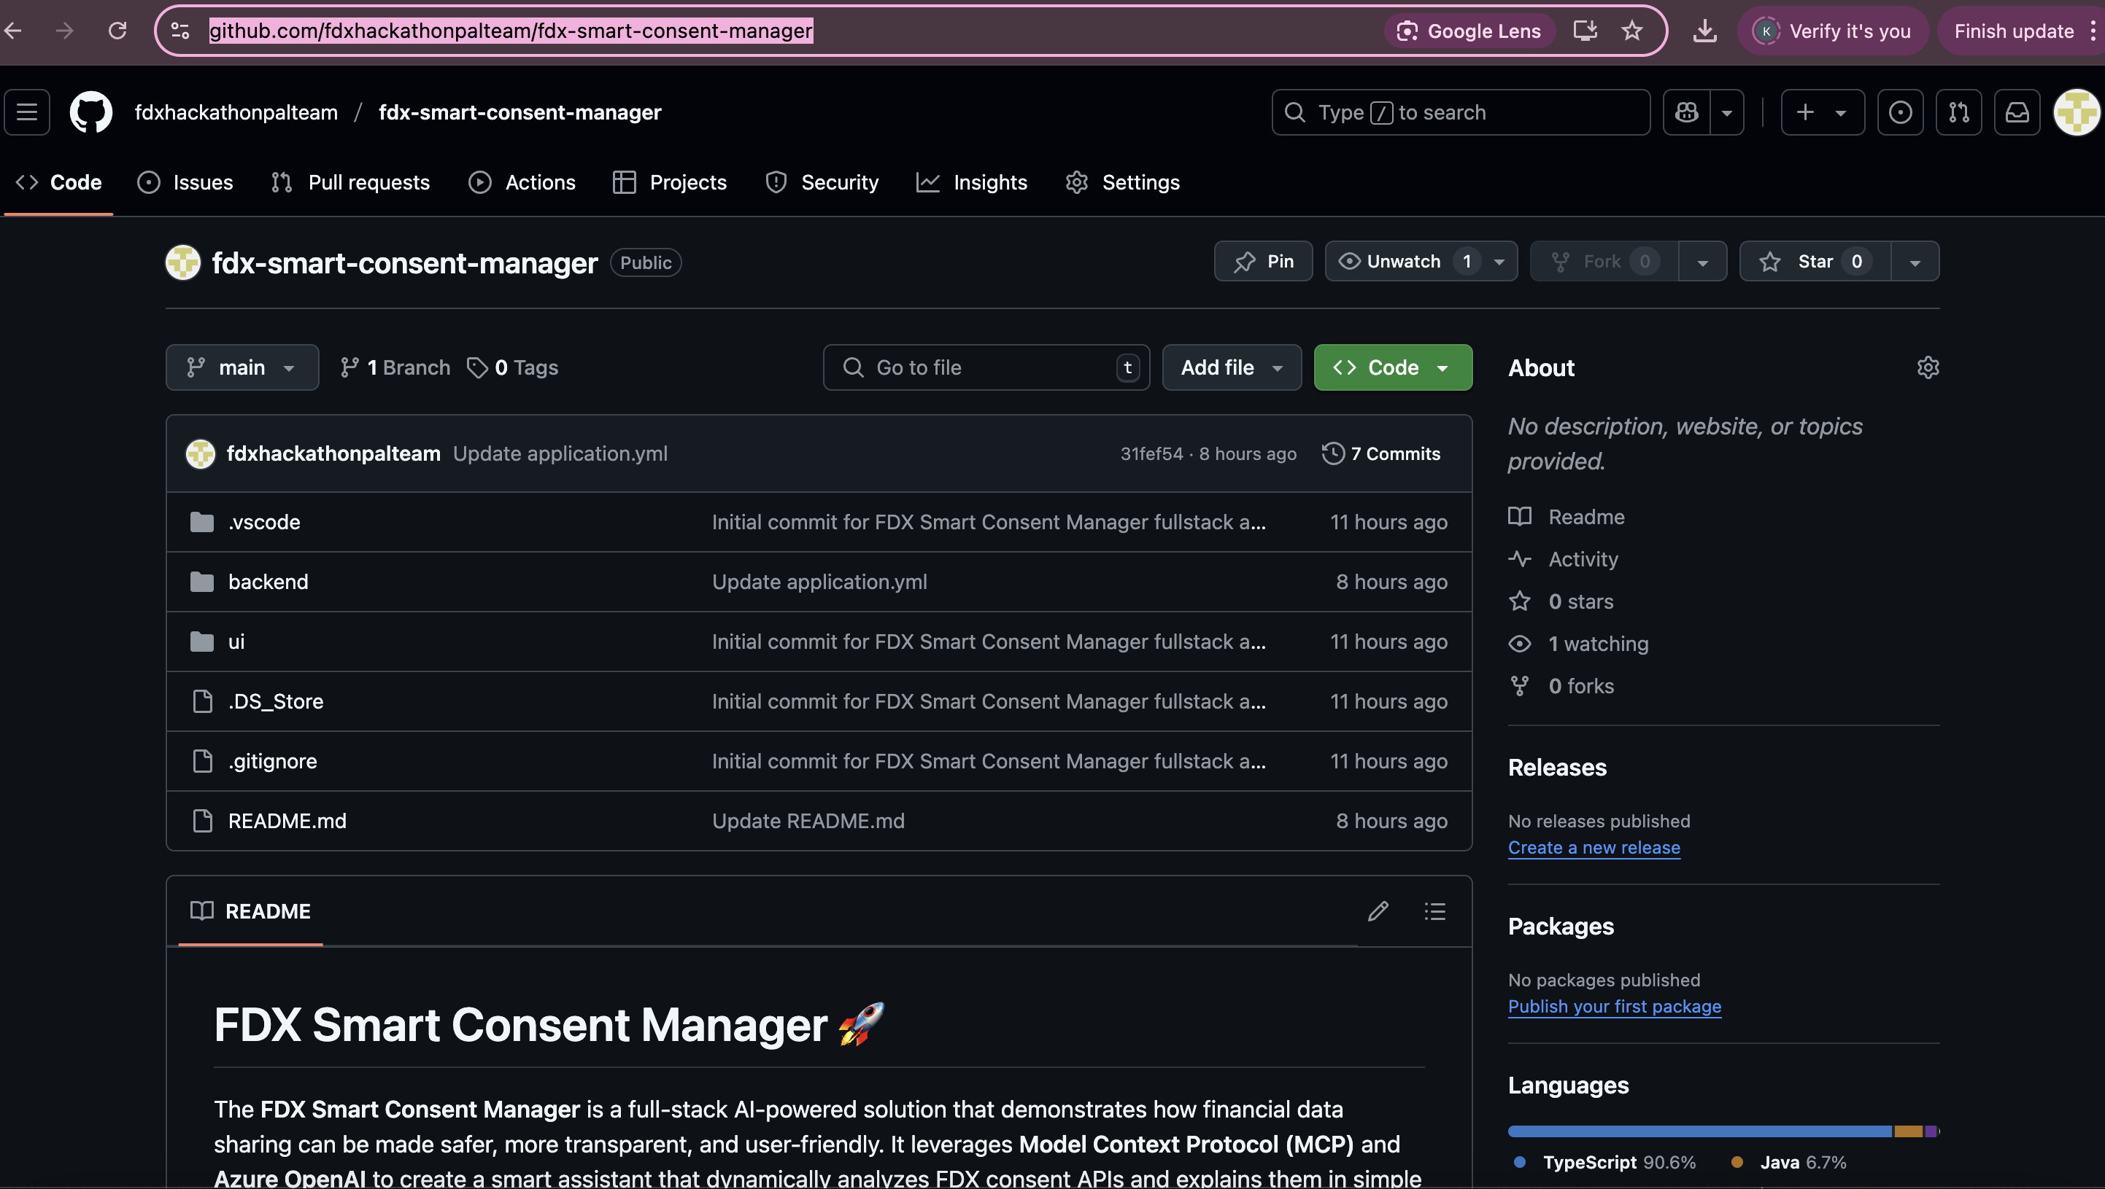
Appendix
Git Repo: https://github.com/fdxhackathonpalteam/fdx-smart-consent-manager

Slide 12
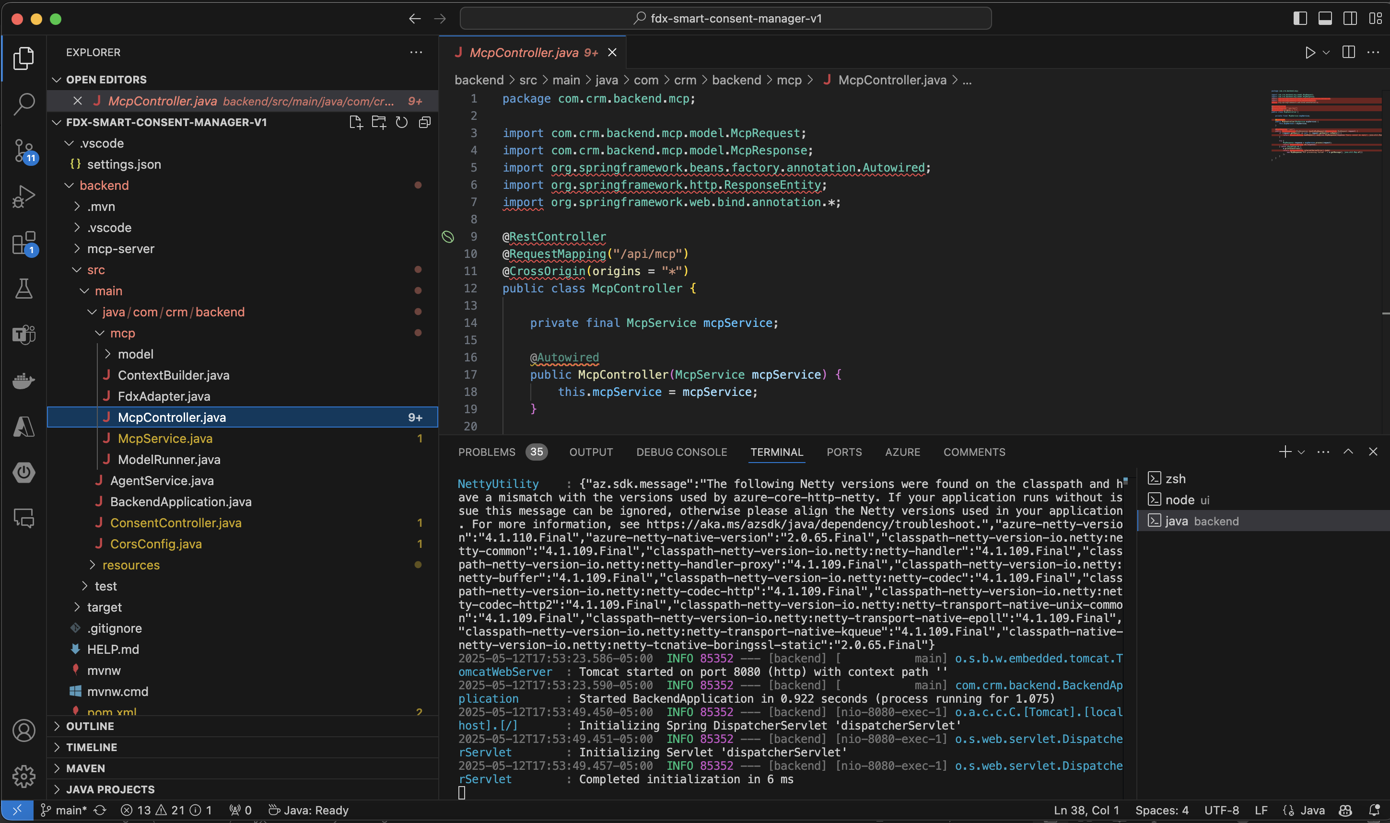
Appendix
Backend Code:

Slide 13
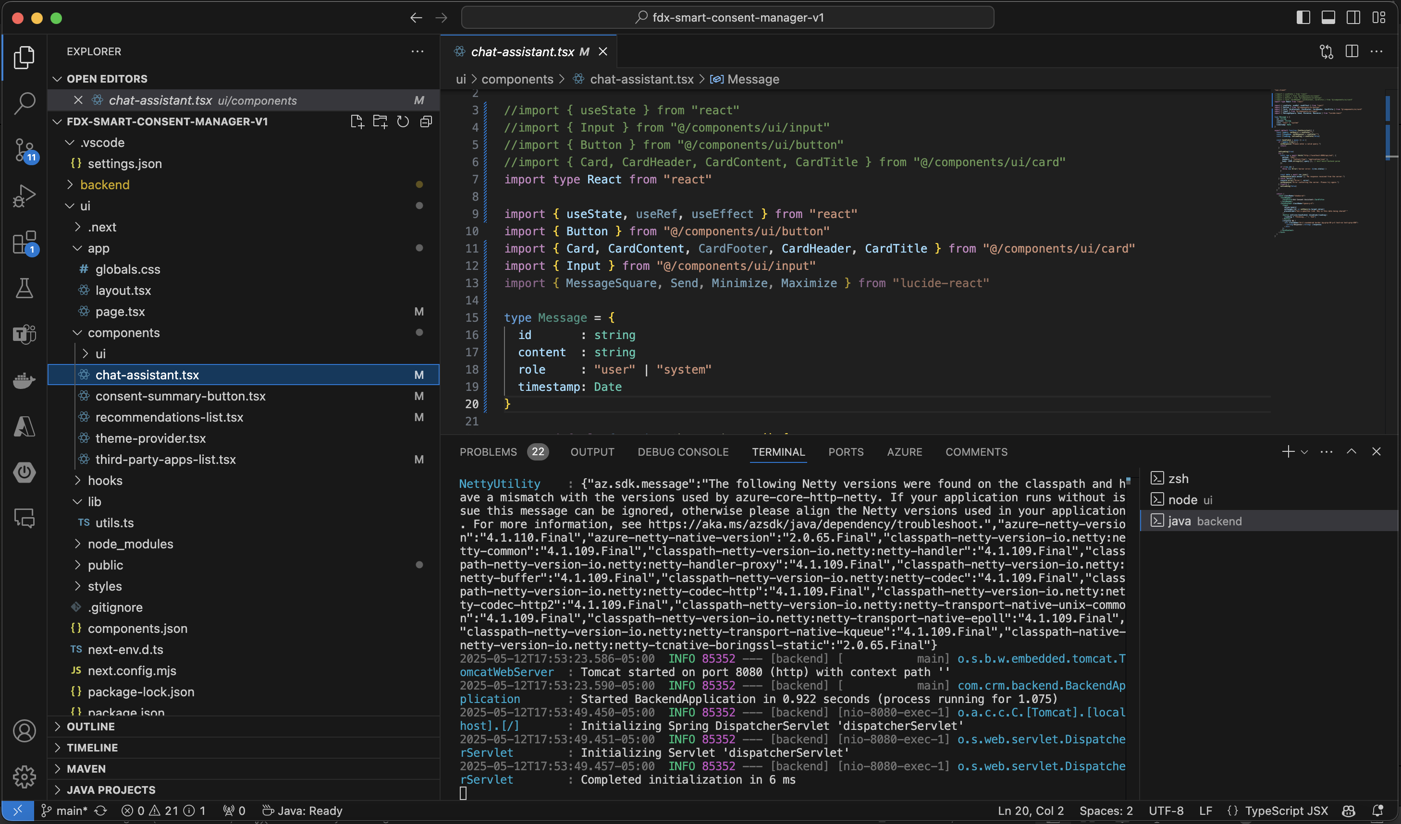
Appendix
Frontend Code:

Slide 14
Q&A

